Slide 1
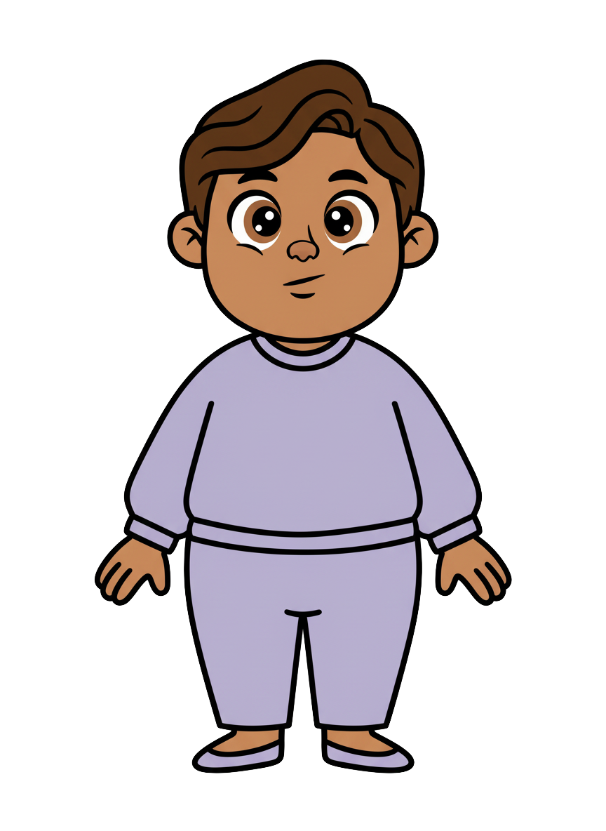
This is Milo

Slide 2
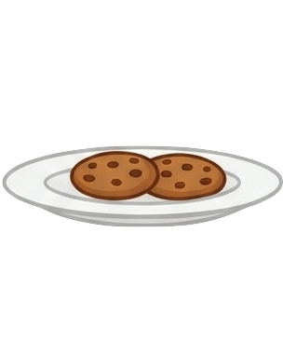
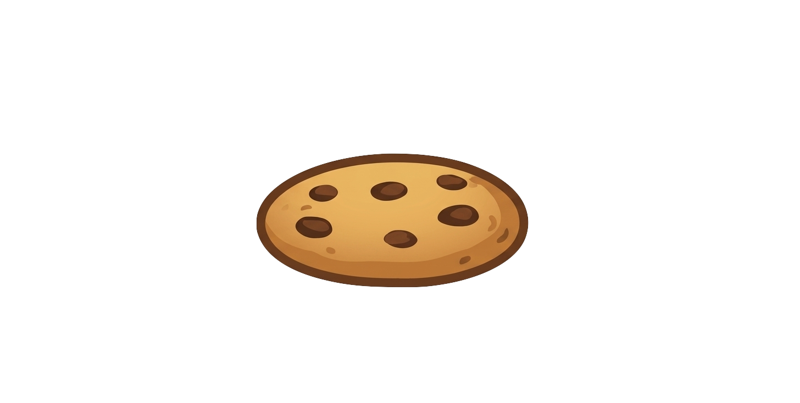
Milo has
three cookies

Slide 3
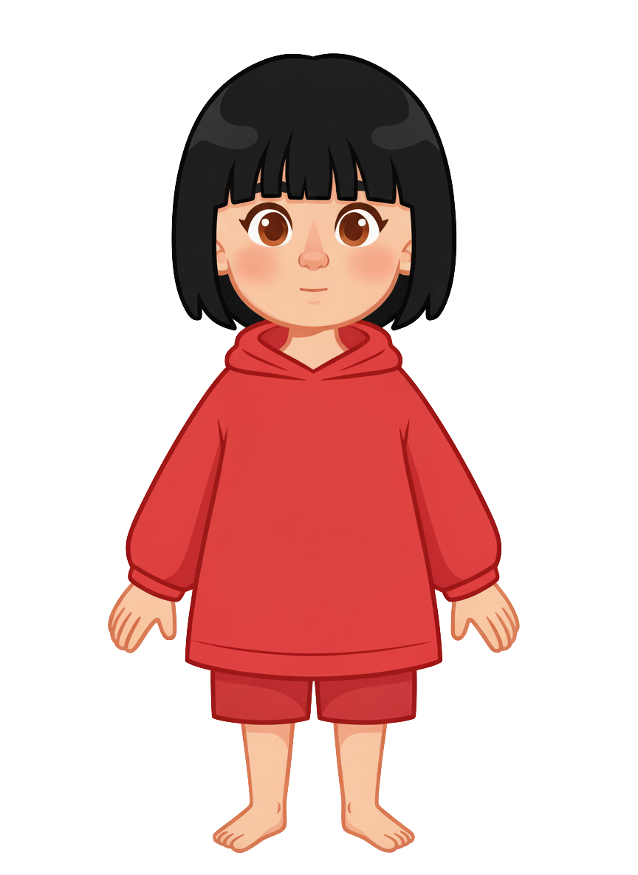
This is Sasha

Slide 4
Sasha has
three cookies

Slide 5
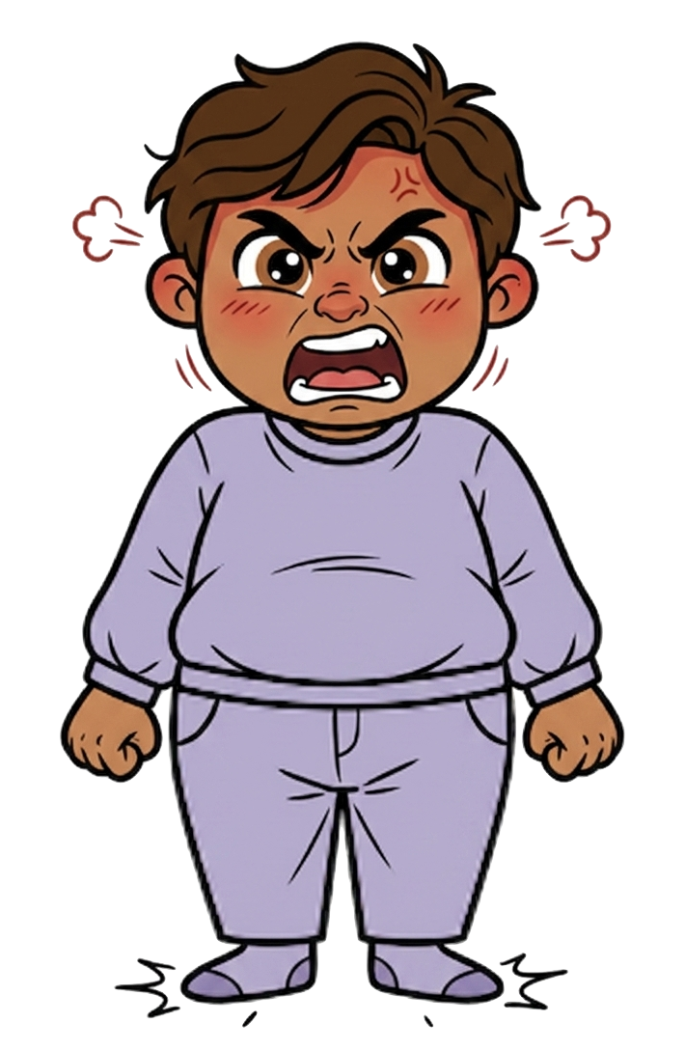
Milo is angry at Sasha.

Slide 6
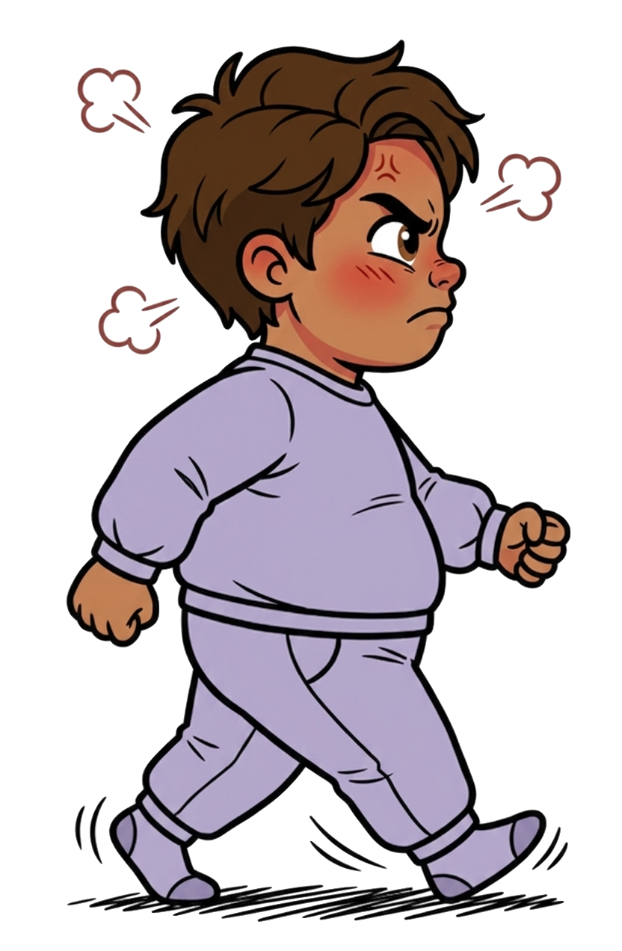
He walks over

Slide 7
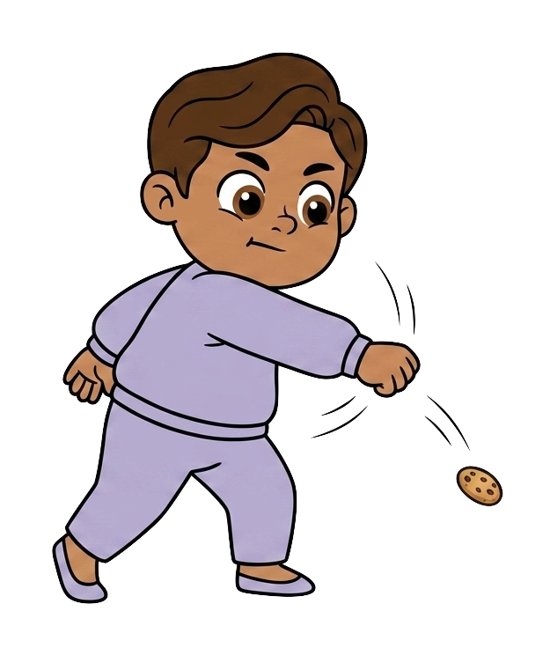
and deliberately smashes one of Sasha's cookies, destroying it.

Slide 8
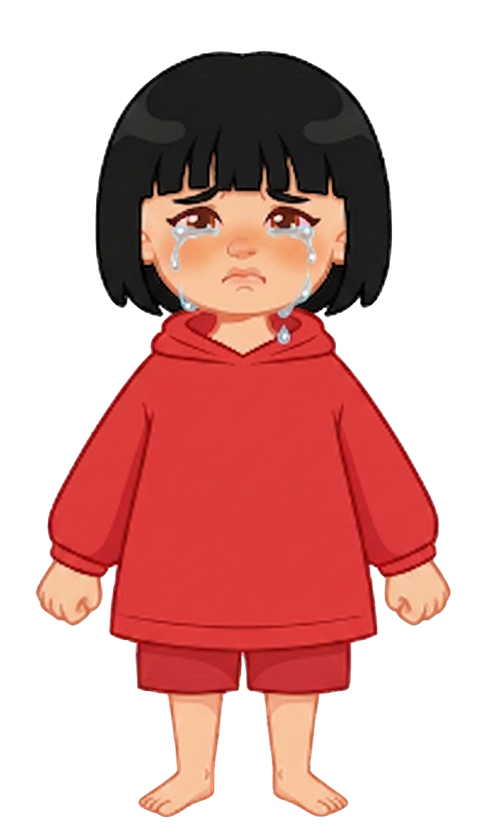
and deliberately smashes one of Sasha‘s cookies, destroying it.

Slide 9
The cookie is gone.

Slide 10
Milo still has 3 cookies. Sasha now has 2 cookies.

Slide 11
Please decide whether you would like to move some of Milo's cookies.

